Slide 1

Visualization and Analysis – Tutorial Presentation for Feedback Date: 25 / 11 / 2024
7COM1079-2024 Student Group No:A177
Group Id: A177 Name of Student Presenting: Ajzal Bin Faisal Madathil

Slide 2
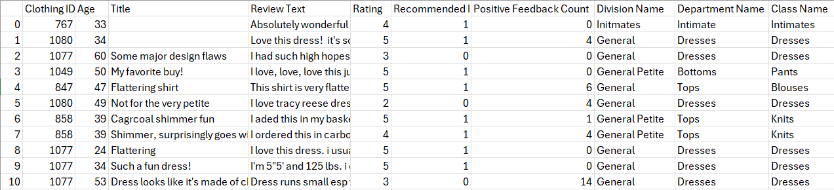
We are using the dataset DS147- Women’s Clothing E-Commerce Reviews.csv to answer our Research Question “Is there a correlation between rating and age in Womens Clothing E-Commerce Reviews ”
The dataset has 23486 rows
The dependent variable is Rating
The independent variable is Age
The dataset represent the Age, review text, Rating and different other attributes of Clothing E-Commerce

Slide 3
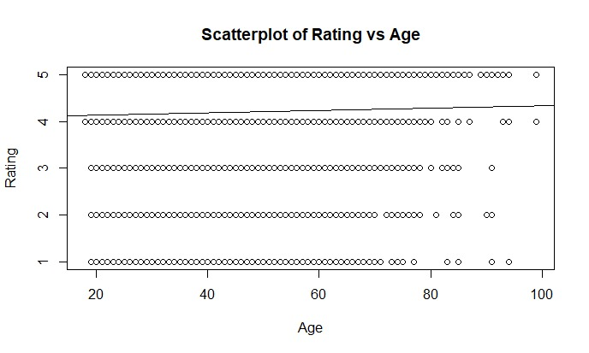
Part 1: VISUALISATION
Scatterplot

Slide 4
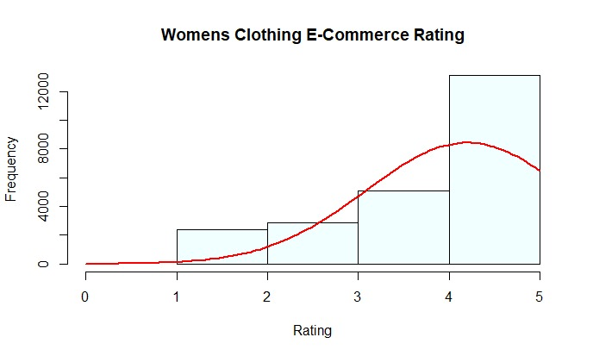
Histogram With Bell curve

Slide 5
Here is a Histogram showing the frequencies of our dependent variable to include the normal curve overlay.
Our RQ asks about Correlation
:
The normal curve overlay does not follow the shape of the underlying data, so for our analysis we use the non-parametric test for correlation that does not assume normality: Spearman’s Rho
5
Notes:
5

Slide 6

R Script and Results – The Analysis
Snippet of the R code used to calculate the test statistics

Slide 7


Slide 8

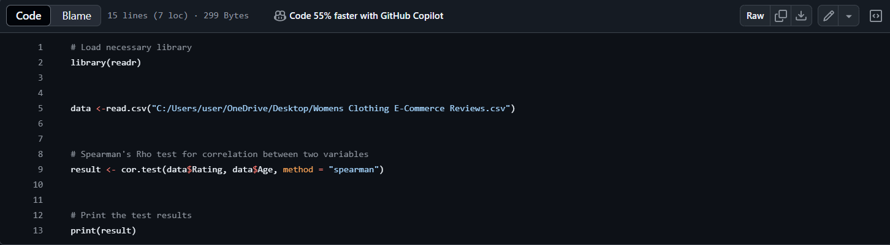

Slide 9
The Value of the Test Statistics
Spearman's rank correlation rho data:
data$Rating and data$AgeS = 2.092e+12 (Sum of squared rank differences).
p-value = 1.895e-06
alternative hypothesis: true rho is not equal to 0
sample estimates: rho 0.03108232

Slide 10
P- Value
P- Value
P-value:p=1.895×10−6
Is p-value > or < 0.05?
p<0.05

Slide 11
Is the result significant?
The analysis shows a positive correlation between the Rating and Age, with a correlation coefficient (rho 0.03108232) indicating that Age is consistently linked to Rating. The p-value (<1.895e-06 ) is much smaller than 0.05, proving the result is statistically significant and not due to chance, leading to the rejection of the null hypothesis.

Slide 12
Decision on the Null Hypothesis
Based on the analysis, we reject the null hypothesis:
The analysis shows a positive correlation between the Rating and Age, with a correlation coefficient (rho 0.03108232) indicating that Age is consistently linked to Rating.
The p-value (<1.895e-06 ) is much smaller than 0.05, proving the result is statistically significant and not due to chance, leading to the rejection of the null hypothesis.

Slide 13
Implications of the Results for Understanding the Research Question (RQ)
The correlation coefficient ( rho = 0.031083 ) shows a positive relationship between the Rating and Age, meaning that as the Age category Depending Rating also tend to increase significantly. This insight is important for understanding the research question (RQ). These findings shows that we can increase the Rating by providing clothes for all age group. Use customer age data to recommend products that suit their style preferences and life stages.

